Slide 1
Introduction to Space Stations
By Matthew Katterman

Slide 2
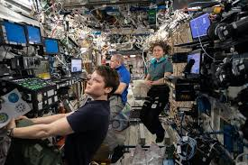
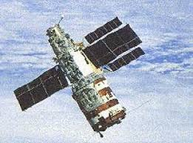
Space Stations
What is a space station?
A large artificial satellite used as a long term base for manned operations in space.
An artificial structure placed in orbit and having the pressurized enclosure, power, supplies and environmental systems necessary to support human habitation for extended periods.
There have been 11 space stations with manned-missions since 1971

Slide 3
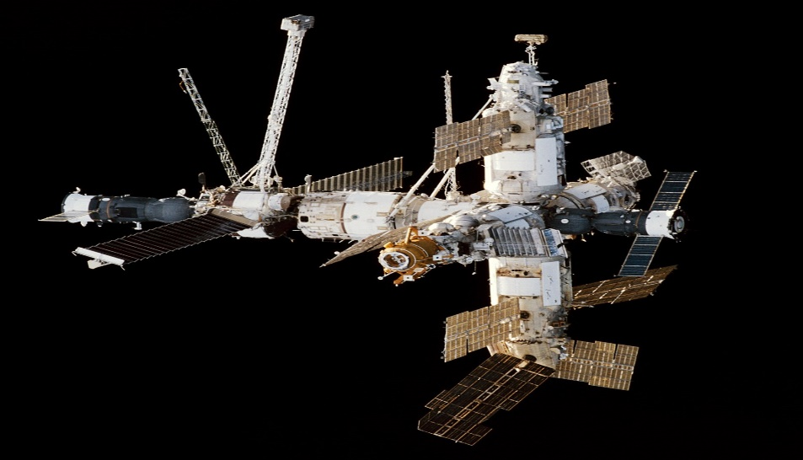
MIR (1986 – 2001)
First modular station that took 10 years to build (1986 – 1996)
Microgravity research station – develop technologies to permanently reside in space.
Did experiments in human biology, physics, astronomy, meteorology.
Has seven or more modules. Core, Kvant1&2, Spektr, Kristall, Priroda, Docking

Slide 4
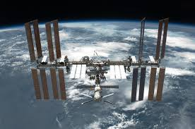
International Space Station (1998 – Present)
Do similar experiments & also astrobiology.
Astrobiology – concerned with the origins, early evolution, distribution and the future of life in the Universe.
Testing of spacecraft systems and equipment needed to do long-duration missions to the Moon and Mars.
Remote Earth Observations – detect sea levels, geological hazards – climate change.
Optimizing resources to improve forest and crop growth.

Slide 5
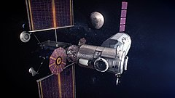
Lunar Gateway (Under Development)
To be built in the 2020’s. A station that orbits the moon for specific missions.
Missions involving astronauts and robots that go to the south pole of the moon.
Launching technology pad for planning Deep Space Transport to Mars.
Manned spacecraft for Science Exploration missions to Mars.
Missions may even be able to visit Asteroids in the future.

Slide 6
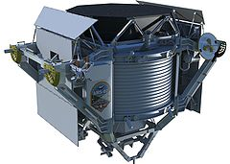
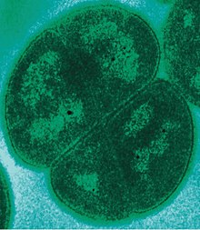
Cool Experiments on ISS
Detecting Dark Matter in the Universe
Doesn’t light up or interact with Electromagnetic Radiation (EM).
Detected with an Alpha Magnetic Spectrometer
What life can travel & survive in space for years?
Experimenting with life on Earth that can survive harsh outerspace conditions – Extremophiles
Survives vacuum, extreme cold, dehydration, acidic environments.

